Slide 1
JAVA and NetBeans Installation
Md. Mizanur Rahman
Lecturer, DIU

Slide 2
JAVA Installation

Slide 3
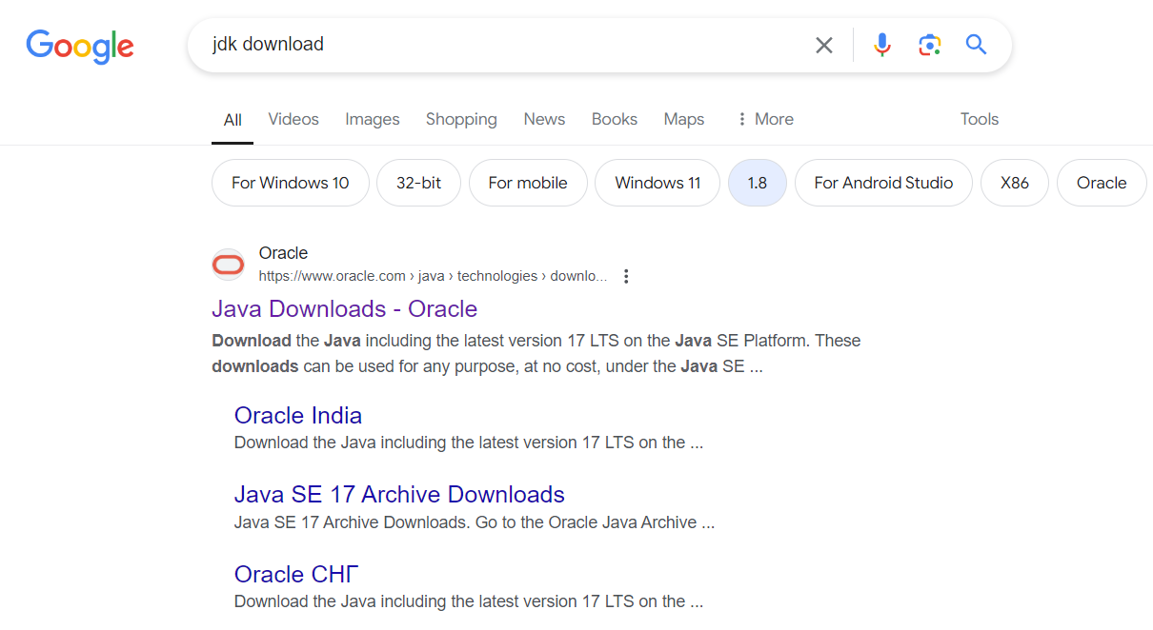

Slide 4
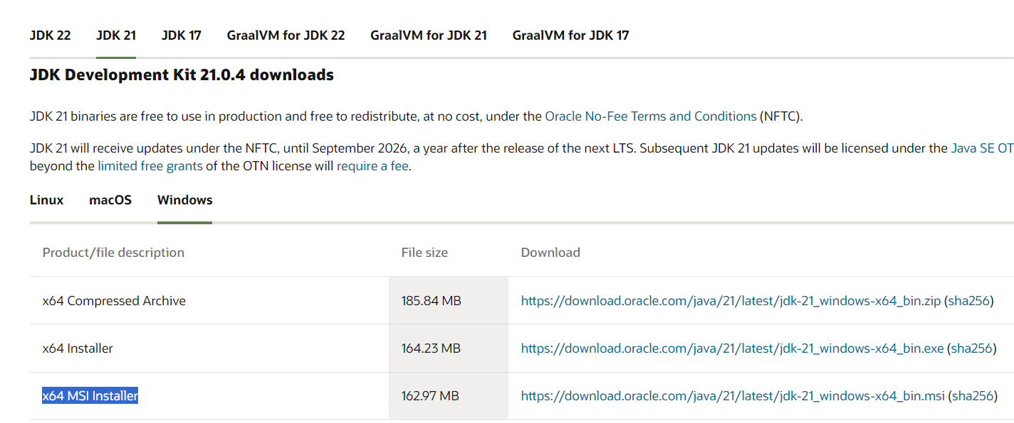

Slide 5
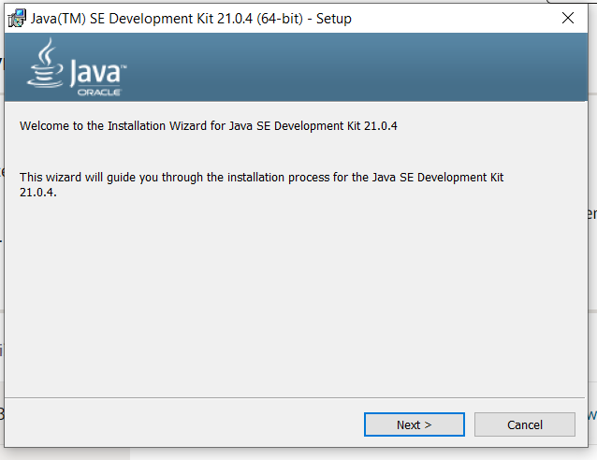
Go to download folder and find the “msi” installer file, double click it to run the file (if a download window pops up click on “Run”.)
Click on Next -> Next -> Install (if required)

Slide 6
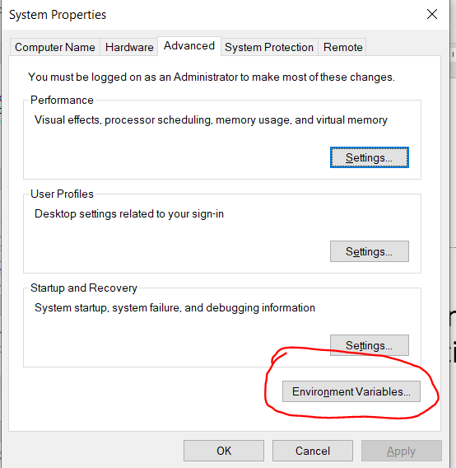
Click on search box.
Type “environment”, a application option will come. Click to open the application.
Click on the marked option to set up “system environment variable” and JAVA_HOME.

Slide 7
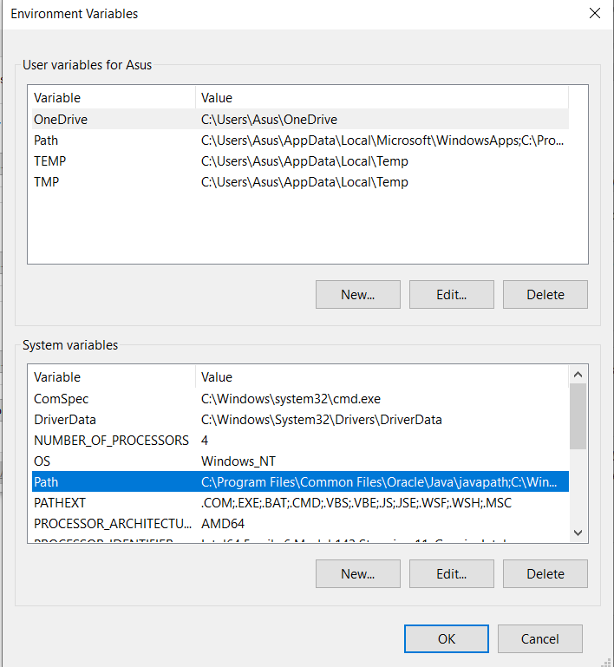
Click on the Selected blue marked area.
Click on “Edit” option below that.

Slide 8
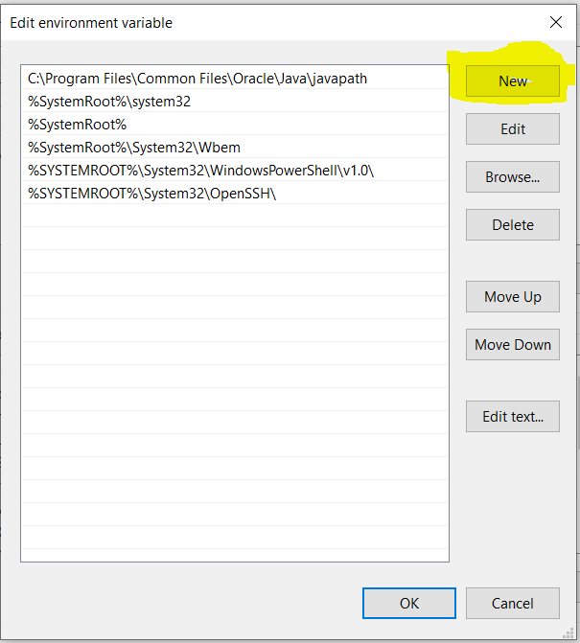
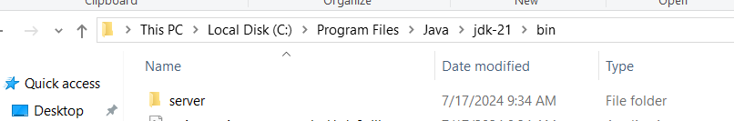
Click on highlighted option to add new Java path.
After clicking the option a box will be created to paste the java bin folder path.
Copy the path shown in the picture. (select and ctrl+c).
Paste the path there and click on “OK”

Slide 9
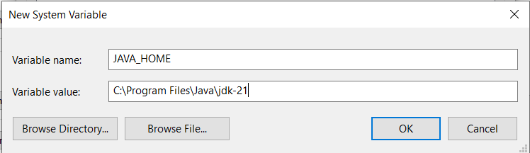
To set up JAVA_HOME system variable, click on the “New” Option.
File the blanks as shown.
Click on “OK”.
Then click “OK” again.

Slide 10
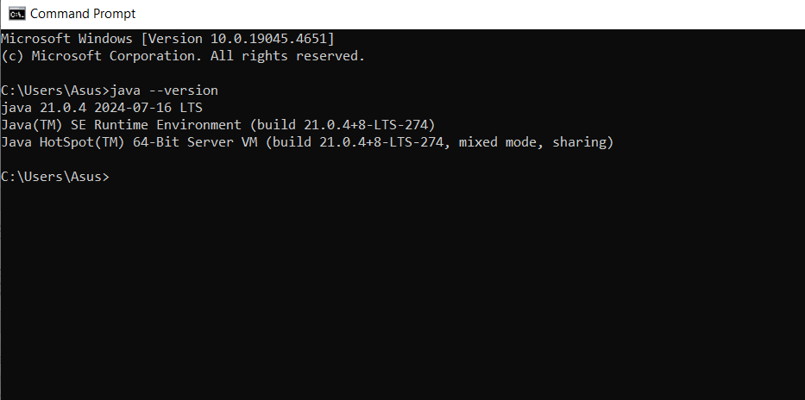
To check if java is installed properly, open “Command Prompt” using the search box (we previously used it to search “environment”.)
Type “java --version” and hit enter. If a reply like this comes then you have installed java properly, Congratulations.

Slide 11
NetBeans Installation

Slide 12
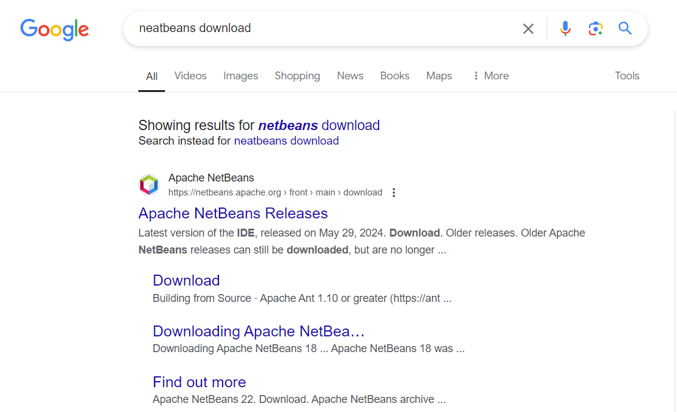

Slide 13
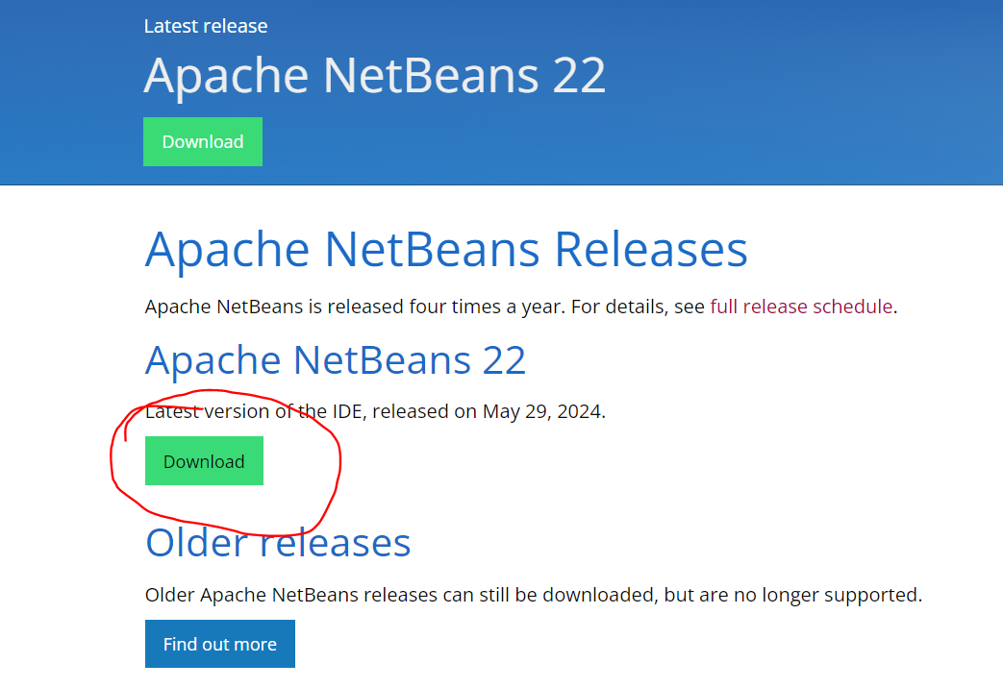

Slide 14
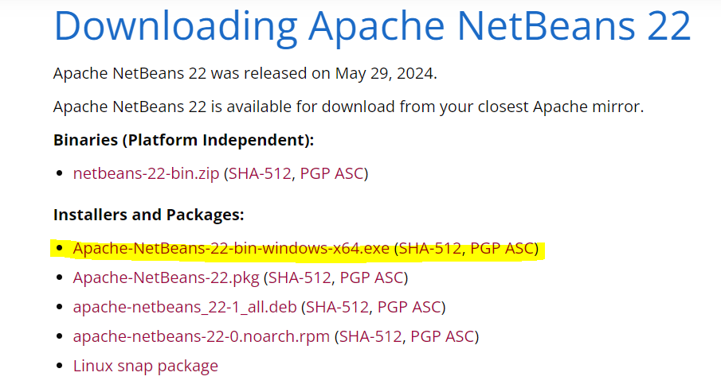

Slide 15
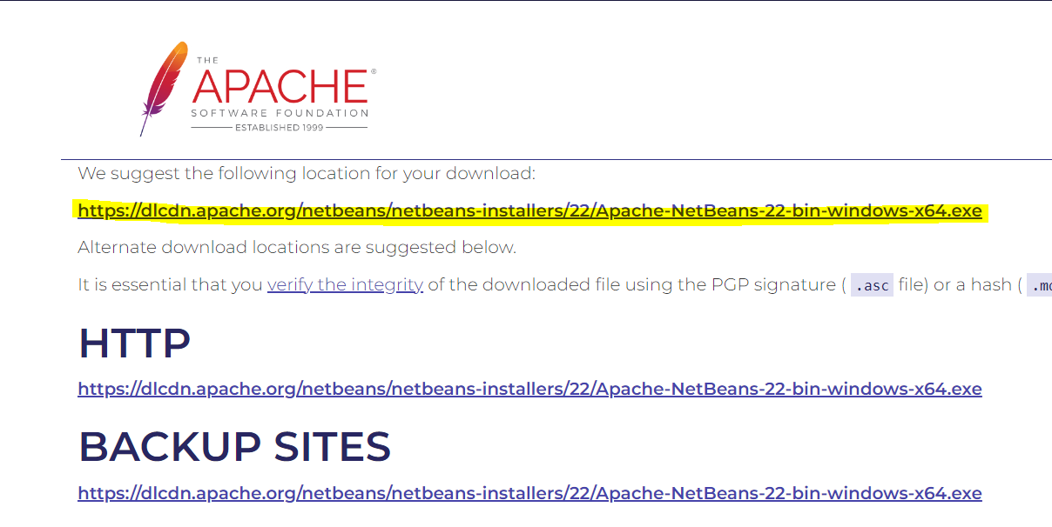

Slide 16
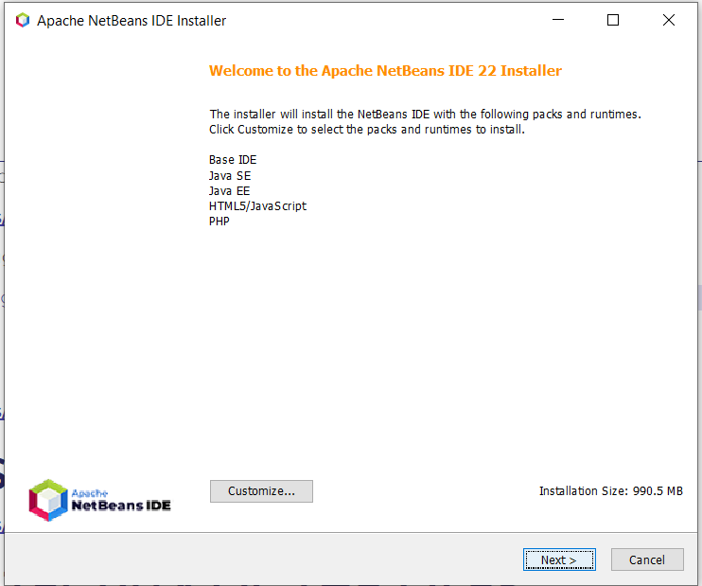
Go to download folder and find the “exe” installer file, double click it to run the file (if a download window pops up click on “Run”.)
Click on Next -> Next (check mark the box on bottom left side) -> Next -> Install

Slide 17
NetBeans Installation COMPLETE !!!

Slide 18
Let’s create our first JAVA application

Slide 19
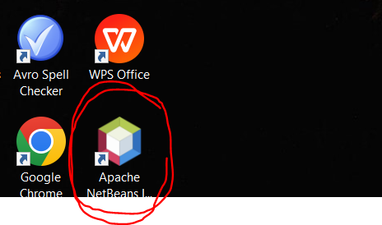
Double click this icon on your desktop.

Slide 20
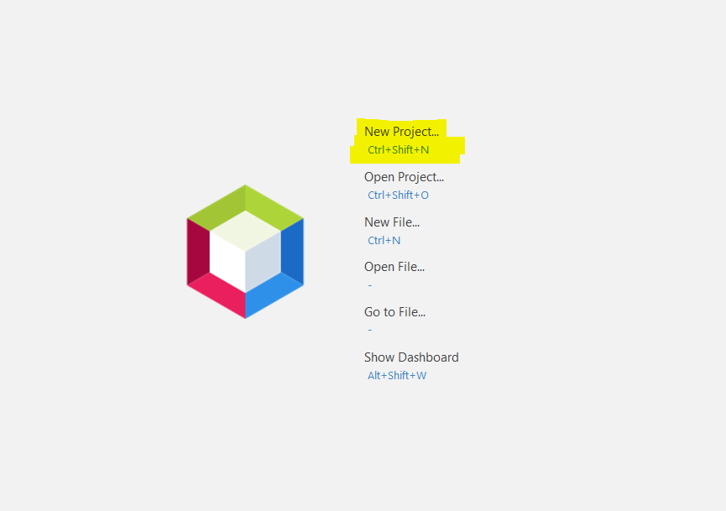
Click on “New Project”.

Slide 21
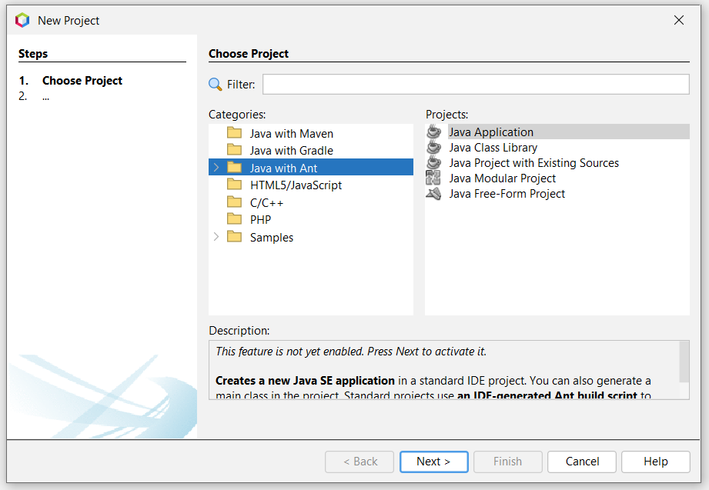
Select the options as shown below and click “Next”.

Slide 22
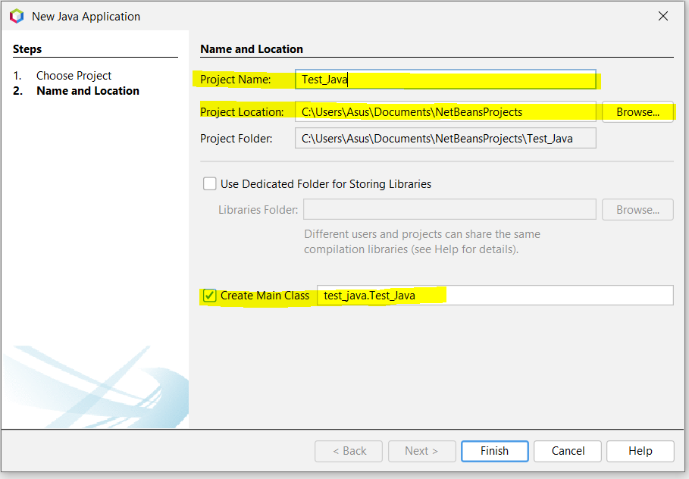
You can change the highlighted part as per your wish. Then click on “Finish”

Slide 23
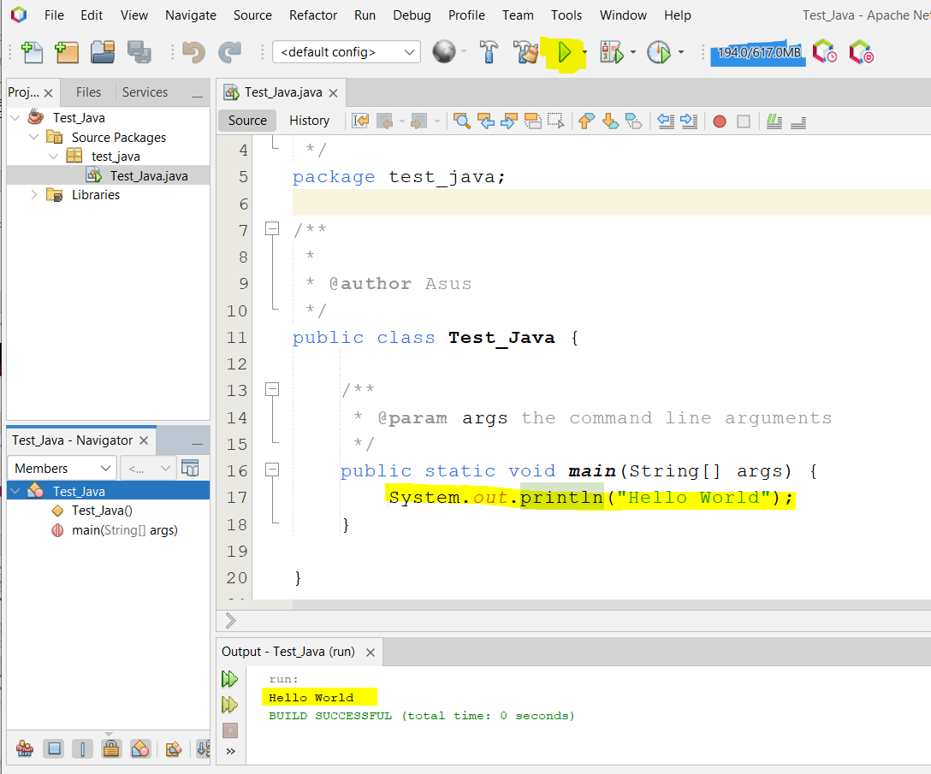

Slide 24
References
https://www.youtube.com/watch?v=SQykK40fFds
https://www.youtube.com/watch?v=_n_5_4bwSn4&t=311s

